Slide 1




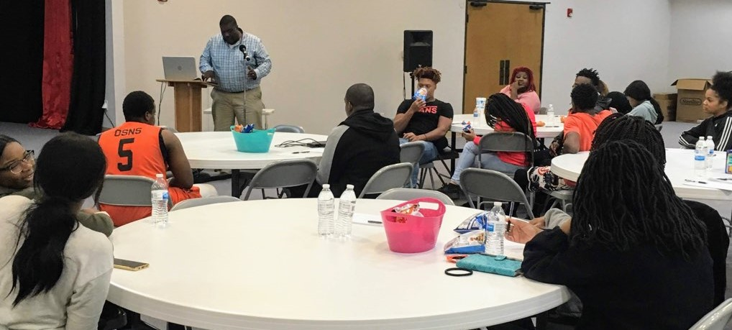
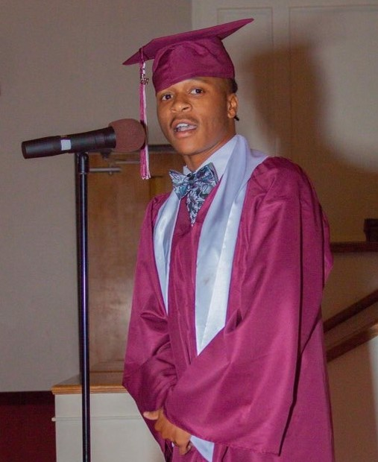

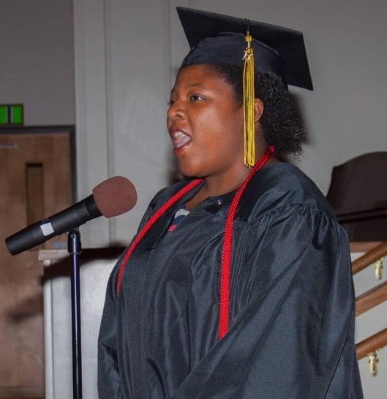
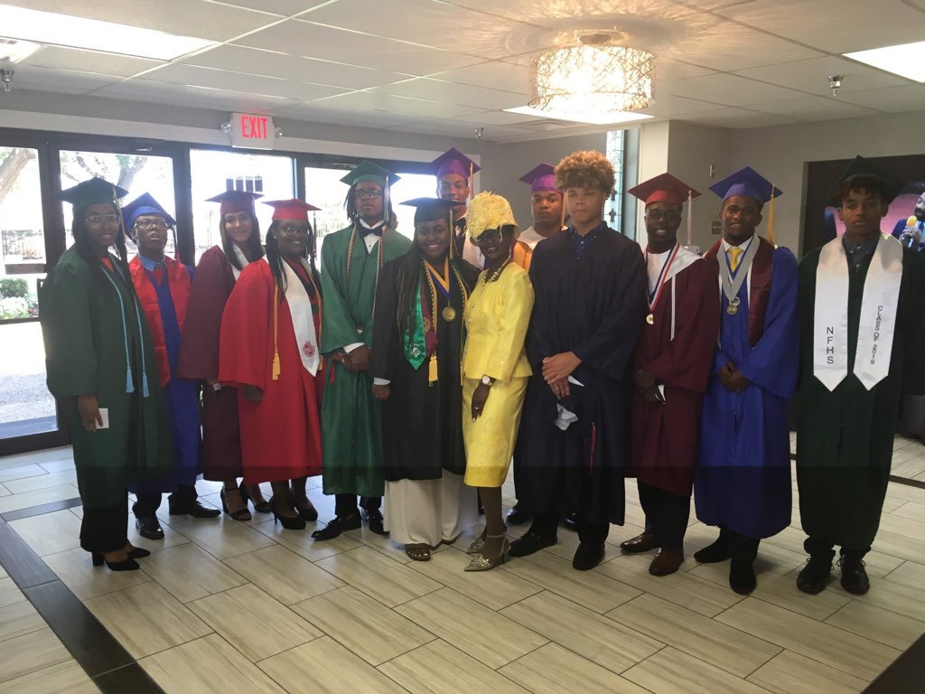
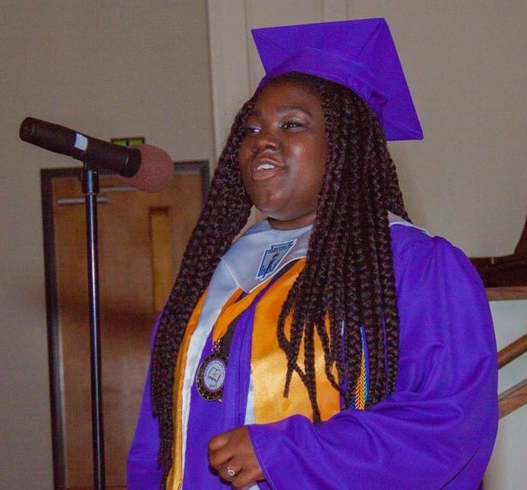
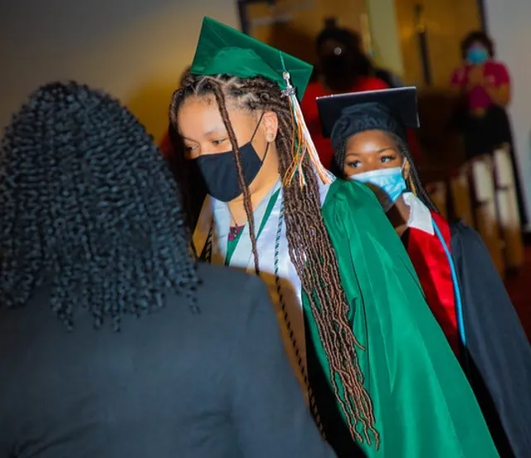

Scholarship - Zoom Meeting
Zoom Link
https://us05web.zoom.us/j/5484345924?pwd=MVBkNVROY2xycUU0cER4OER4V0xzQT09
Meeting ID
548 434 5924
Passcode
895055

