Slide 1



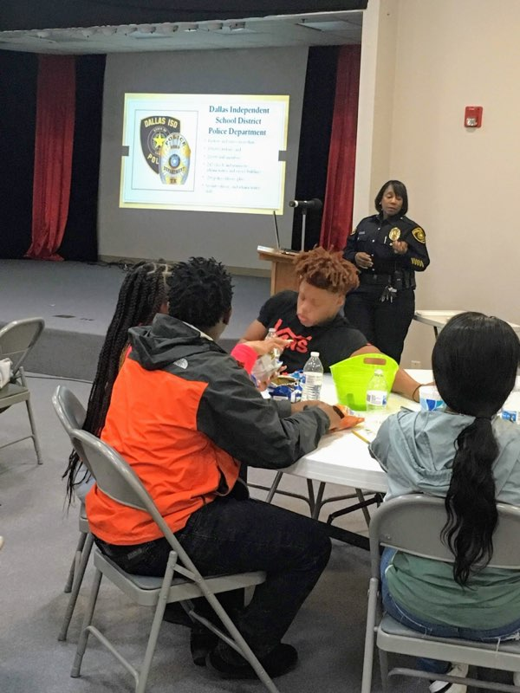
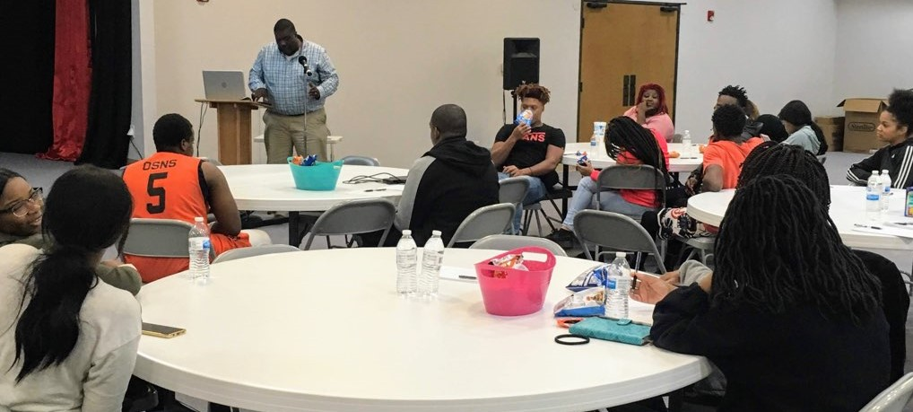



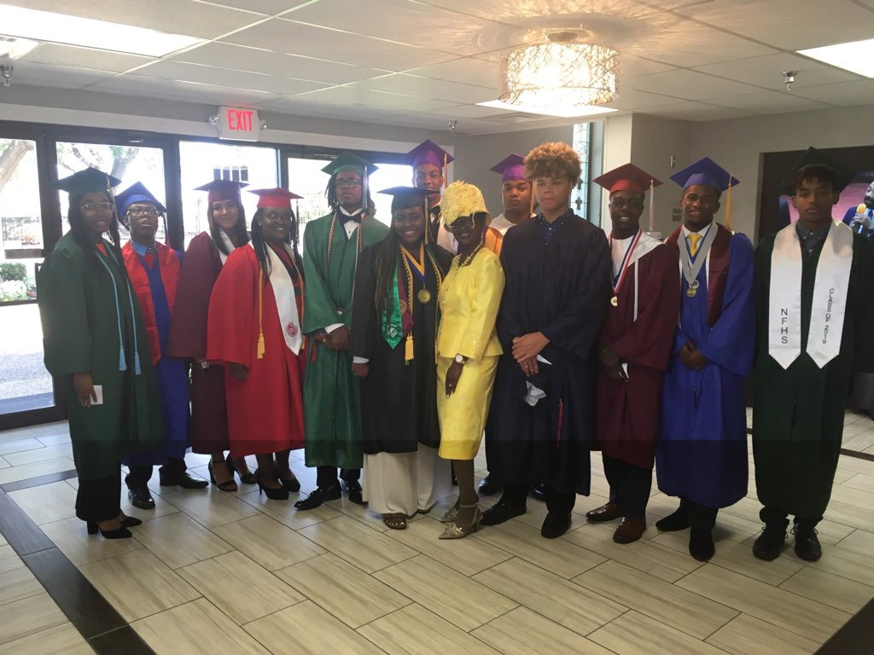
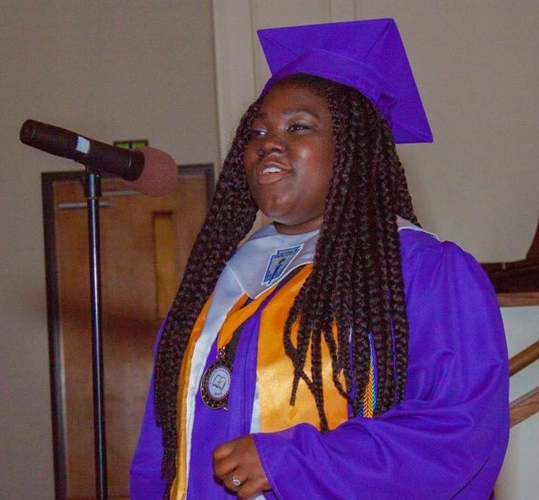


MIDDLE - HIGH SCHOOL PLANNING
MIDDLE - HIGH SCHOOL PLANNING
8th - 9th PLANNING
10th PLANNING
11th PLANNING
12th PLANNING

