Slide 1
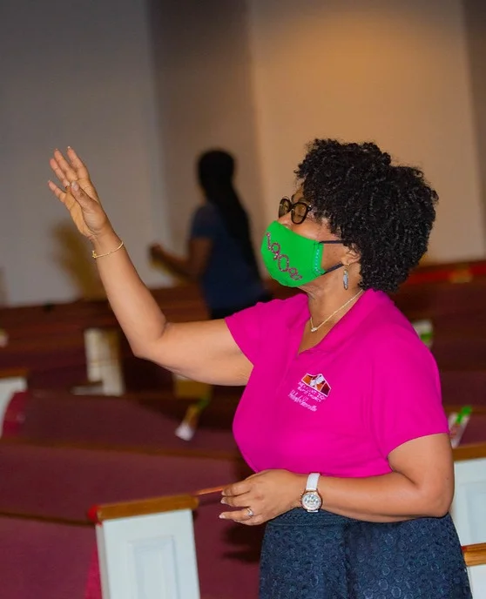
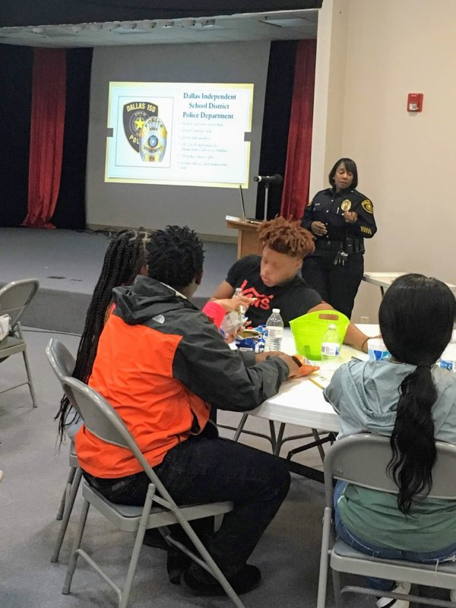
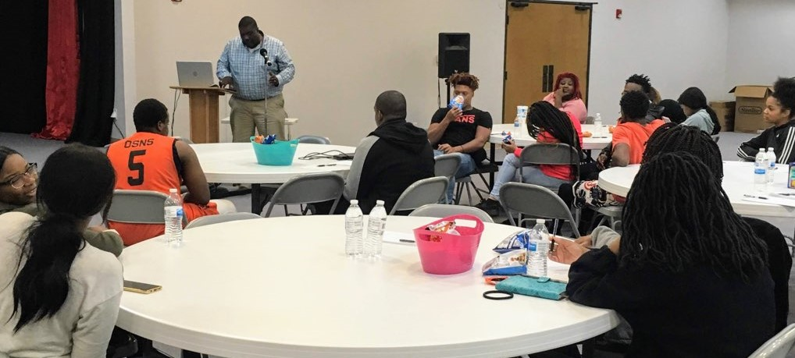
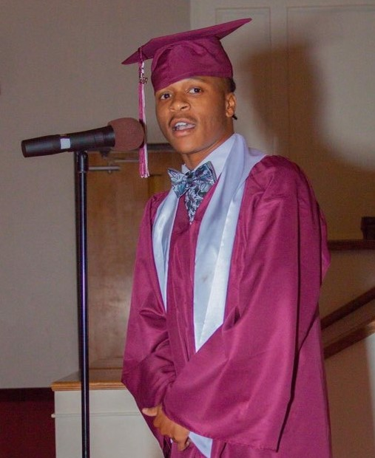
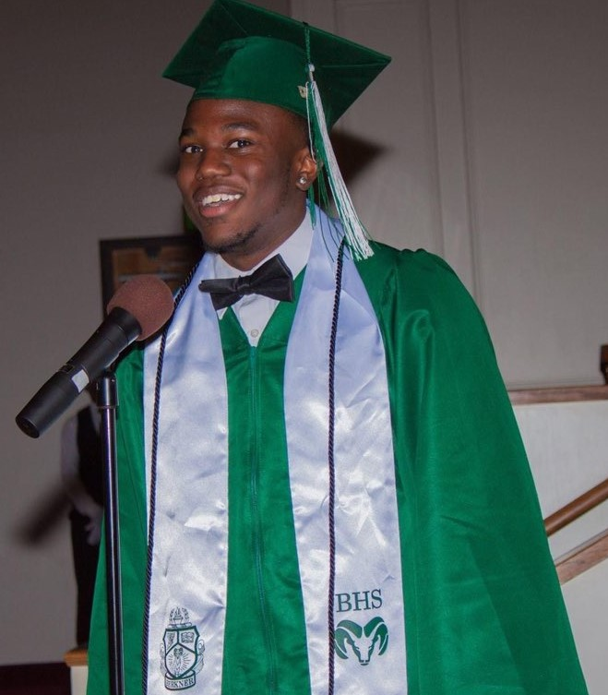
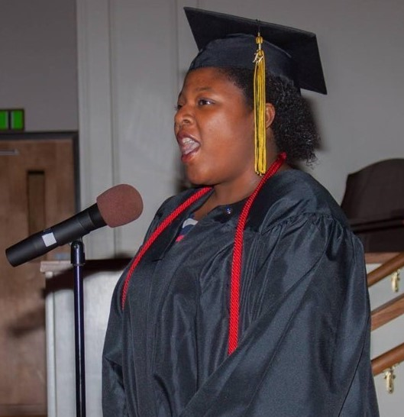
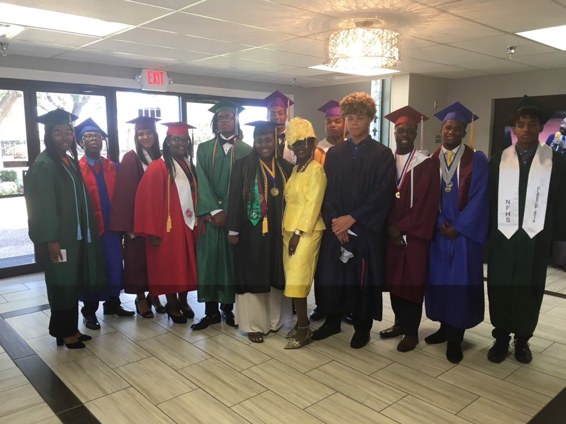
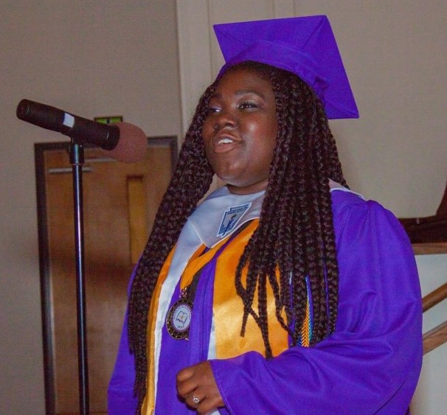
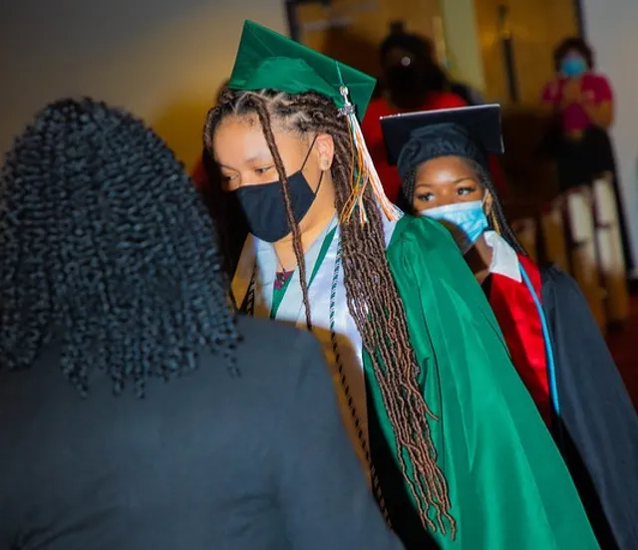
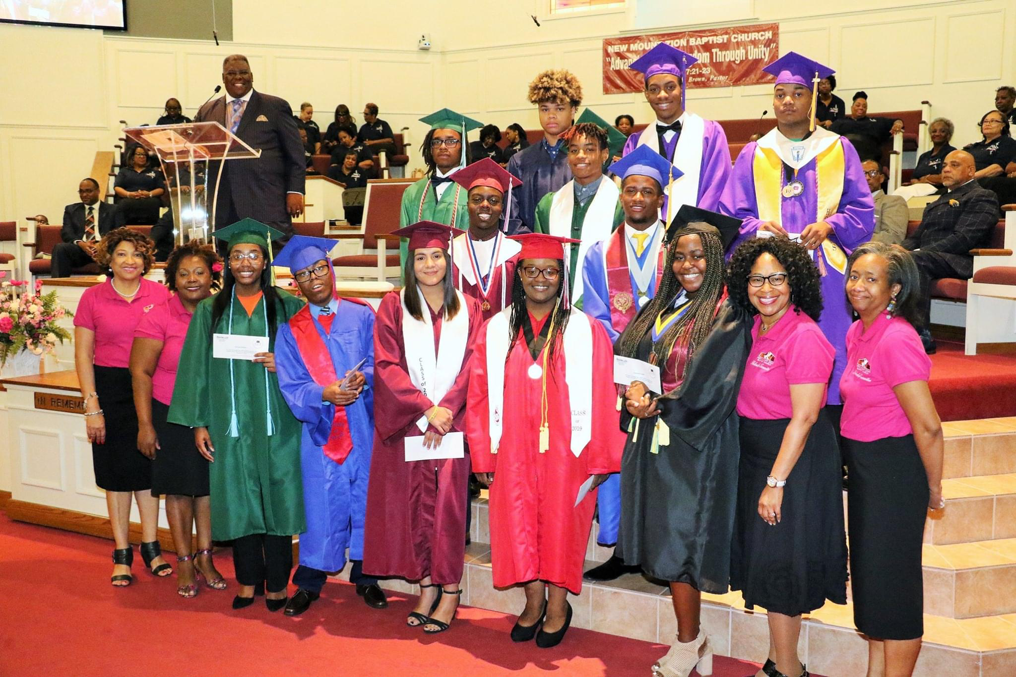
Scholarships to Apply
The purpose of the scholarship is to provide New Mount Zion Baptist Church students with tools and resources to achieve their higher education goals. The ministry also provides a relatable forum to discuss ways to reach their goals of entering college, trade/vocational training, or the military. Students are honored for their academic work, community service and church participation. The committee has two functioning parts: Information and Financial Award (Scholarship). We present 4-year planning tools, essay writing assistance, other scholarship opportunities, and forums. The scholarship is based on GPA, recommendation letters, essays, participation in the youth ministry and the fulfillment of all requirements needed to be accepted into any college/university, trade/vocational training, or military.
Please click one of the tabs below to get more information
Thurgood Marshall College Fund
Various Deadlines
7/15/2023 Deadline
Fashionably Greek Scholarship

